Slide 1
Median
Measure of Central Tendency

Slide 2
Problem Statement
A teacher wants to understand the performance of her students based on their recent math test scores. She doesn't want the extremely high or low scores to skew her interpretation of the class’s general performance. Instead, she would like to identify a "middle" score that divides the class in such a way that half of the students scored below this point and half scored above it. Can you help her find this middle score using a reliable method and explain why this approach is effective?

Slide 3
Solution: Finding the Median
To determine the "middle" score without being affected by outliers, we can calculate the median of the test scores. The median is a measure of central tendency that represents the middle value of a sorted data set, providing a balanced view of the class's performance.

Slide 4
Steps to Find the Median for Ungrouped Data
Step 1: Arrange the Scores
First, we need to organize the scores in ascending order. Let’s say the scores for the 11 students are as follows:
45, 52, 53, 55, 57, 60, 63, 67, 70, 90, 100
Step 2: Finding the Median Position
Since there are 11 scores (an odd number), the median is the score right in the center of this ordered list. In this case, the sixth score is 60.
Thus, the median test score is 60.

Slide 5
Why the Median is Effective?
The median gives a clear picture of the class’s typical performance because it isn’t influenced by the highest (100) or lowest (45) scores. By using the median, the teacher gets an accurate sense of the class's central performance level, without the results being skewed by outliers.

Slide 6
Example with an Even Number of Values
Suppose the teacher has test scores for 10 students:
45, 52, 53, 55, 57, 60, 63, 67, 70, 90
Here’s how to find the median:
Arrange the Scores The scores are already in ascending order.
Identify the Two Middle Values With 10 values, the middle values are the fifth and sixth scores:
57 and 60
Calculate the Median To find the median, we take the average of these two middle values:

Slide 7
Why This Works
When there are an even number of values, taking the average of the two middle values gives a balanced central point between the two halves of the data set. This way, the median continues to represent the "middle" performance, unaffected by extreme scores.

Slide 8
Finding Median for Grouped Data
For grouped data, the median is found using a different approach, as the data is organized into intervals or "classes" rather than individual values. Here’s how to calculate the median for grouped data with an example.
42, 45, 47
51, 53, 55, 56, 58
61, 63, 64, 65, 66, 67, 68, 69
71, 72, 74, 75, 76, 78
81, 83, 85, 87

Slide 9
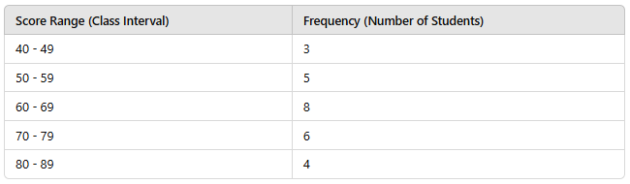
Example: Finding the Median for Grouped Data
Let’s say a teacher has grouped her students’ test scores into intervals, and the frequency of students in each interval is shown below:

Slide 10
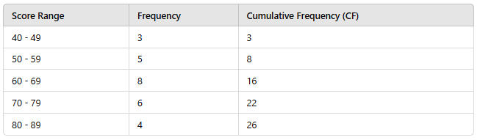
Step 1: Calculate the Cumulative Frequency
The cumulative frequency (CF) is the running total of students up to each interval.

Slide 11
Step 2: Determine the Median Class
Total number of students (N) = 26
Find N/2​, which is 26/2 = 13
Locate the class interval where the cumulative frequency is equal to or just greater than 13. Here, the median class is 60 - 69 because the cumulative frequency reaches 16 at this interval.

Slide 12

Step 3: Use the Median Formula for Grouped Data
For grouped data, the median is calculated using the formula:
Where:
L = Lower boundary of the median class = 60
N = Total frequency = 26
F = Cumulative frequency of the class before the median class = 8
f = Frequency of the median class = 8
h = Class width (size of each interval) = 10

Slide 13
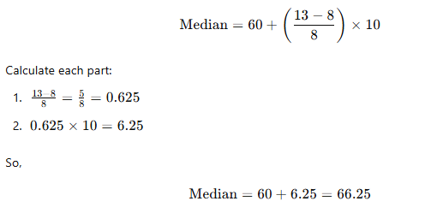
Step 4: Plug in the Values

Slide 14
Why This Approach Works
The formula provides a way to estimate the middle value by identifying the interval containing the median and adjusting for the position within that interval. This gives a reliable approximation of the median in grouped data, reflecting the central tendency accurately.

Slide 15
Example 1: Real Estate - Analyzing Home Prices in a Neighborhood
A real estate agent is helping a client understand home prices in a neighborhood. The client wants to know the typical price of a home without being influenced by the extremely high prices of luxury homes or the low prices of small apartments. By calculating the median home price, the agent can give a realistic expectation of what homes cost in that area.

Slide 16
Solution
Suppose the agent collects the following sale prices (in thousands of dollars) for homes in the neighborhood:
[150, 200, 210, 220, 230, 240, 245, 250, 260, 270, 800]
Step 1:
Sort the Data:
Sorted prices: [150, 200, 210, 220, 230, 240, 245, 250, 260, 270, 800]
Step 2:
Find the Median: Since there are 11 prices, the middle value (6th item) is 240.

Slide 17
Interpretation
The median home price is $240,000. This value isn’t influenced by the luxury home priced at $800,000, which would have skewed an average calculation. The median here gives the client a better understanding of the "typical" price range in the neighborhood.

Slide 18
Example 2: Healthcare - Analyzing Hospital Wait Times
A hospital administrator wants to analyze the wait times in the emergency room to improve patient satisfaction. Extreme cases, such as those requiring immediate attention (short wait times) or patients with non-urgent needs (long wait times), can skew the average wait time. The administrator decides to calculate the median wait time to get a better sense of what a typical patient experiences.

Slide 19

Solution
Suppose the hospital collects wait times (in minutes) from 10 patients in a day:
[10, 15, 18, 20, 25, 30, 35, 40, 45, 120]
Sort the Data:
[10, 15, 18, 20, 25, 30, 35, 40, 45, 120]
Identify the Two Middle Values (Even Dataset): Since there are 10 values, we take the average of the 5th and 6th values:

Slide 20
Interpretation
The median wait time is 27.5 minutes. This median accurately reflects a typical wait time for most patients, avoiding skewed results due to the patient who had to wait 120 minutes due to non-urgent needs. The hospital can use this information to make staffing or process improvements around the median experience.

Slide 21
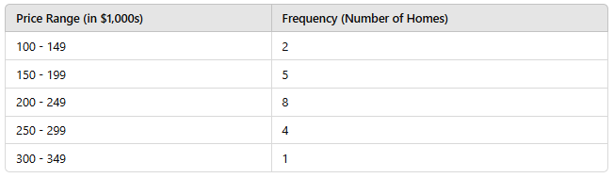
Example 1: Real Estate - Grouped Home Prices in a Neighborhood
A real estate agent wants to determine the typical home price in a neighborhood. Since prices range widely, grouping them into intervals can make it easier to interpret.
Grouped Data for Home Prices

Slide 22
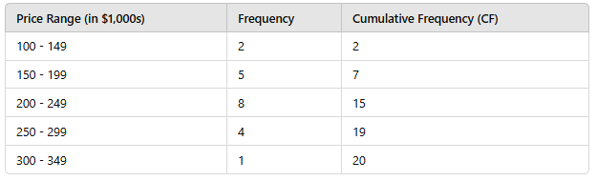
Solution: Finding the Median for Grouped Data
Calculate the Cumulative Frequency

Slide 23
Determine the Median Class
Total number of homes N=20
N/2=10, so the median class is where the cumulative frequency just exceeds 10.
The median class is therefore 200 - 249 because the cumulative frequency reaches 15 in this interval.

Slide 24

Apply the Median Formula
Using the formula for grouped data:
Where:
L = Lower boundary of the median class = 200
F = Cumulative frequency before the median class = 7
f = Frequency of the median class = 8
h = Class width = 50 (since 249 - 200 = 50)

Slide 25
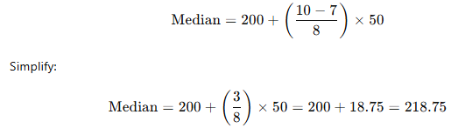
Plugging in the values:
So, the median home price is approximately $218,750.

Slide 26
Example 1: Environmental Science - Analyzing Daily Air Quality Index (AQI)
An environmental scientist is studying daily air quality index (AQI) values in a city over ten days to understand the typical air pollution level. Since AQI can fluctuate and is recorded as a decimal, the scientist wants a reliable measure that represents a typical day’s AQI without being skewed by outliers.

Slide 27
AQI Data (in ppm - parts per million)
[35.4, 36.7, 40.3, 41.1, 42.6, 43.8, 44.9, 47.2, 48.3, 50.5]

Slide 28

Solution
Sort the Data (already sorted in this case):
[35.4, 36.7, 40.3, 41.1, 42.6, 43.8, 44.9, 47.2, 48.3, 50.5]
Identify the Middle Values (Even Dataset): Since there are 10 values, we take the average of the 5th and 6th values:

Slide 29
Interpretation
The median AQI value is 43.2 ppm. This gives the scientist an idea of the central air quality level without being affected by possible outliers, such as the highest value at 50.5.

Slide 30
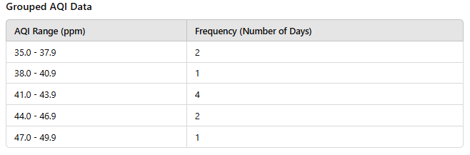
Example 1: Environmental Science - Grouped Daily Air Quality Index (AQI)
An environmental scientist is studying daily air quality index (AQI) values in a city over a 10-day period. To simplify the data, AQI values are grouped into ranges.

Slide 31
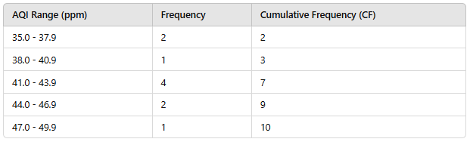
Solution: Finding the Median for Grouped Data
Calculate the Cumulative Frequency

Slide 32

Determine the Median Class
Total number of days N=10
N/2=5, so the median class is the interval where the cumulative frequency reaches or exceeds 5.
The median class is therefore 41.0 - 43.9.
Apply the Median Formula
Using the median formula for grouped data:

Slide 33
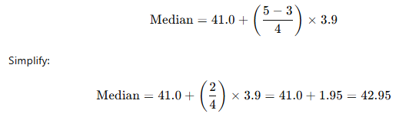
Where:
L = Lower boundary of the median class = 41.0
F = Cumulative frequency before the median class = 3
f = Frequency of the median class = 4
h = Class width = 2.9 (since 43.9 - 41.0 = 2.9)
Plugging in the values:
So, the median AQI value is approximately 42.95 ppm.

Slide 34
Example 2: Food Industry - Grouped Sugar Content in Soft Drinks
A food scientist groups sugar content data from several soft drink samples to understand the typical sugar content level without being skewed by outliers.

Slide 35
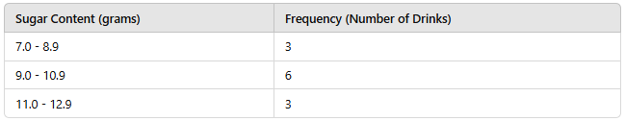
Grouped Sugar Content Data

Slide 36
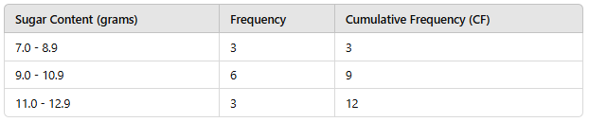
Solution: Finding the Median for Grouped Data
Calculate the Cumulative Frequency

Slide 37
Determine the Median Class
Total number of drinks N=12
N/2=, so the median class is where the cumulative frequency reaches or exceeds 6.
The median class is 9.0 - 10.9.

Slide 38

Apply the Median Formula
Using the median formula for grouped data:
Where:
L = Lower boundary of the median class = 9.0
F = Cumulative frequency before the median class = 3
f = Frequency of the median class = 6
h = Class width = 1.9 (since 10.9 - 9.0 = 1.9)

Slide 39
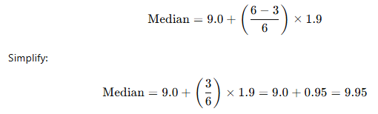
Plugging in the values:
So, the median sugar content is approximately 9.95 grams per serving.

Slide 40
Why to Prefer Median over Mean

Slide 41
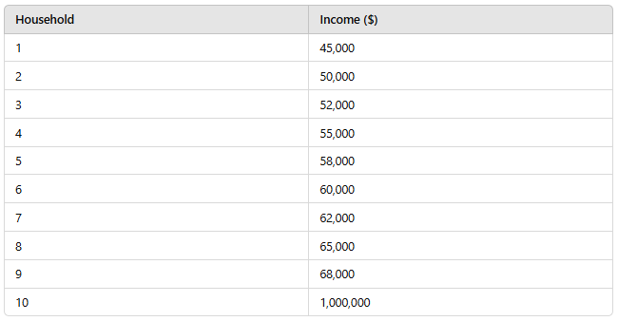
Example: Household Income in a Neighborhood
Imagine you're analyzing household income in a neighborhood to understand the typical earning power of residents. Suppose you survey the incomes of ten households, and the results are as follows:
In this data, most households earn between $45,000 and $68,000 per year, but one household has an exceptionally high income of $1,000,000.

Slide 42
Calculating the Mean and Median
Mean:
The sum of all incomes is $1,515,000.
The mean income is $1,515,000 ÷ 10 = $151,500.
Median:
Sorting the incomes, we find that the middle two values are $58,000 and $60,000 (since we have an even number of households).
The median income is ($58,000 + $60,000) ÷ 2 = $59,000.

Slide 43
Interpretation
The mean income is $151,500, which is heavily influenced by the one household with $1,000,000 in income. This doesn’t accurately reflect what most people in the neighborhood earn.
The median income is $59,000, which is a much better representation of a "typical" household income in this neighborhood, as it falls within the range of most of the households.

Slide 44
Why Median is Preferred Here
In cases like this, the median is more useful because it gives a realistic picture of typical income levels without being skewed by extreme outliers. For a city planner, a social worker, or a housing market analyst, the median provides a more accurate insight into the financial landscape of the neighborhood, which can help in planning resources, understanding economic diversity, or making fair comparisons with other areas.

